Slide 1


Deep Dive Into US College Enrollment Data

Slide 2

Table Of Contents
1.
Introduction
2.
Geographic: State Intakes
3.
Socioeconomic: Endowment Assets
4.
Geographic: SAT Scores
5.
Socioeconomic: NC - HBCU
6.
Demographics: Race
7.
Demographics: Gender
8.
Geographic: Freshman Intakes
9.
Future Scope

Slide 3

Background
The United States is a global leader in post-secondary education providing opportunities for students in diverse backgrounds. Since 1965, affirmative action policies implemented during the Civil Rights Movement aimed to level the playground for minorities and those from underprivileged settings. However, in June 2023 the Supreme Court’s landmark decision to repeal affirmative action marks a significant turning point in US education policy.

Slide 4

Aim:
This project aims to visualize the impact of the decision by analyzing data related to college admissions and enrollments across demographic groups.

Slide 5

Question:
What does the data reveal about college admissions and enrollment demographics? What insights can we gain into the potential implications of this policy shift?

Slide 6


Geographic: State Intakes

Slide 7
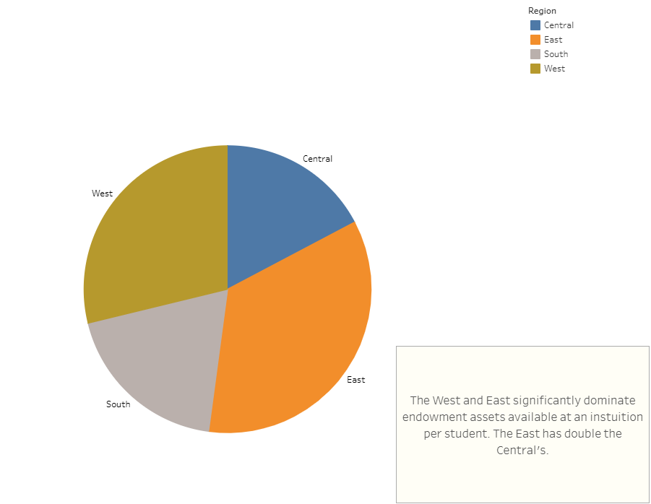

Socioeconomic: Endowment Assets

Slide 8

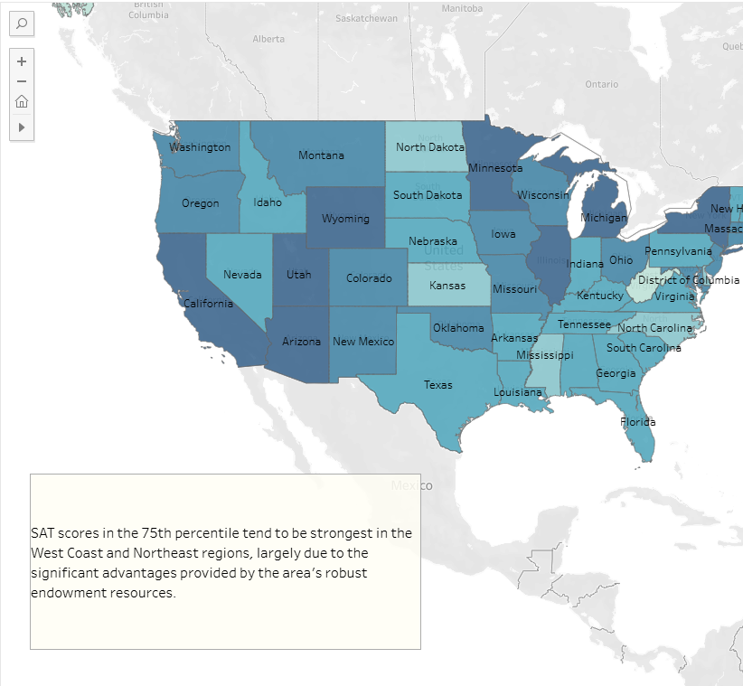
Geographic: SAT Scores

Slide 9

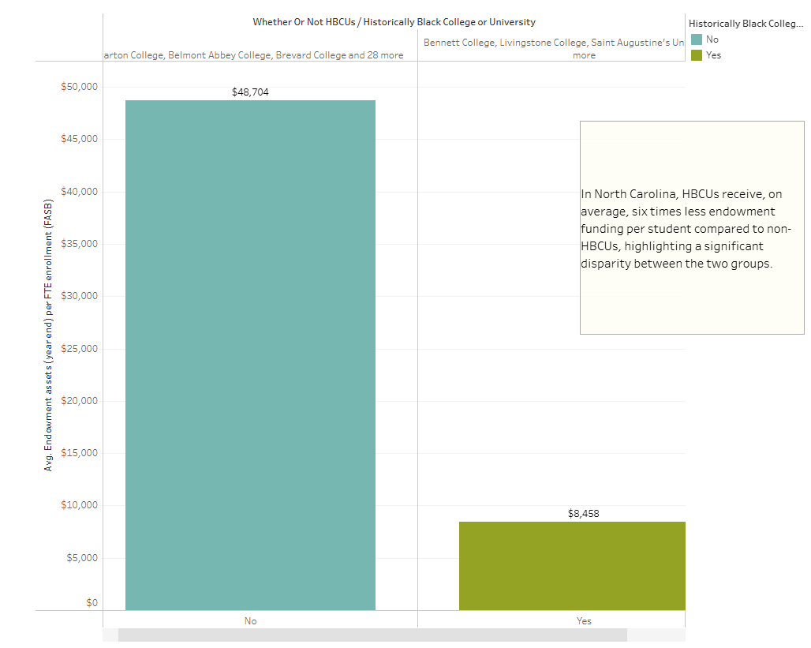
Socioeconomic: NC - HBCU Endowment Assets

Slide 10
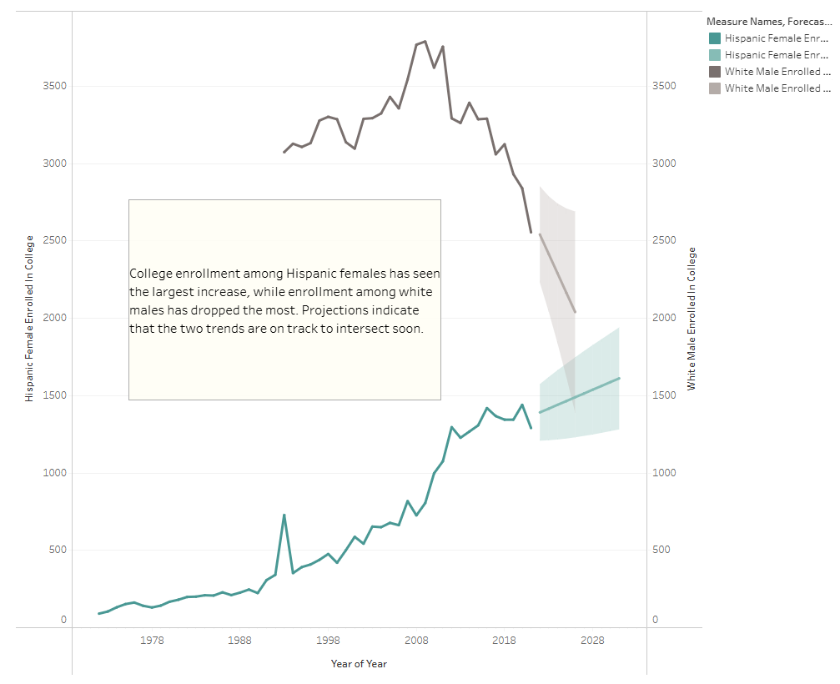

Demographics: Race

Slide 11
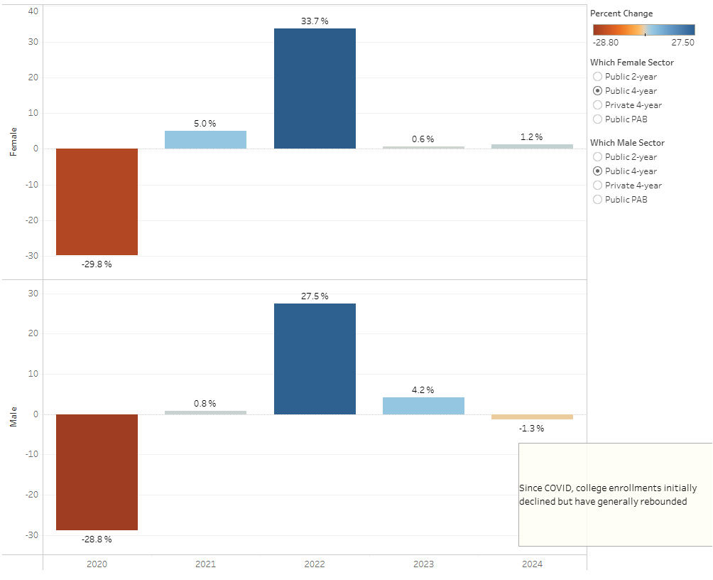

Demographics: Gender

Slide 12

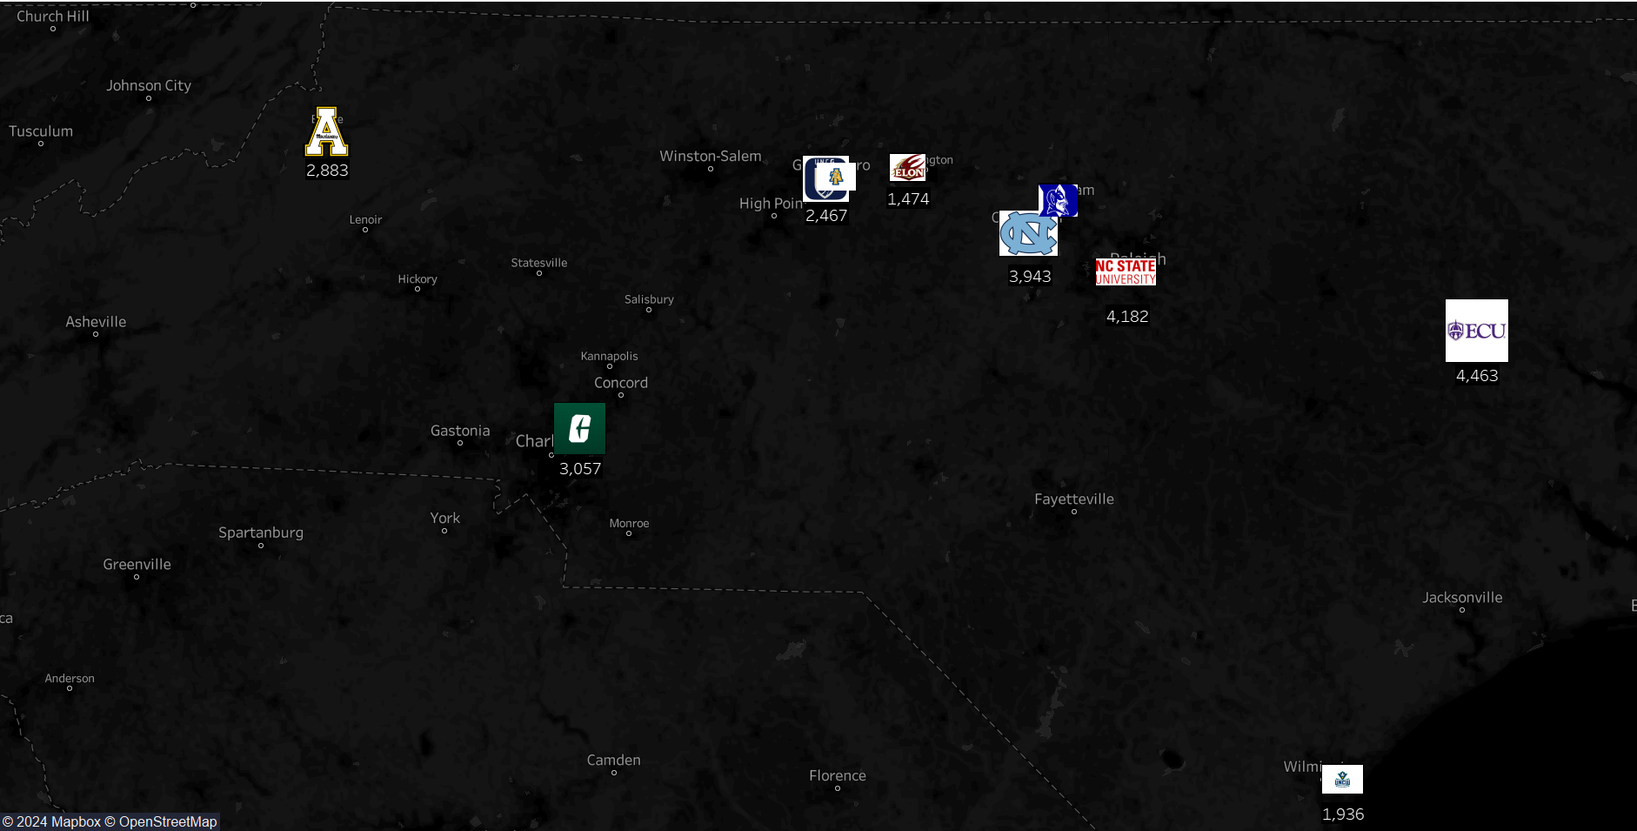
Geographic: Yearly Freshman Enrollment

Slide 13

Future Scope
In July 2023, the Supreme Court overturned affirmative action, eliminating race-conscious admissions decisions. As a result, future data may reflect a very different story compared to the trends of the past 60 years. Monitoring how these changes impact college demographics and enrollment patterns will be crucial in the coming years to ensure a more equitable society.

Slide 14

References
[1] “National Student Clearinghouse Center” | Enrollment Coverage 2003-2016, https://nscresearchcenter.org/workingwithourdata
[2] “National Student Clearinghouse Center” | Current Enrollment Estimates, https://nscresearchcenter.org/current-term-enrollment-estimates/
[3] “United States Census Bureau” | CPS October Enrollment Tables, https://www.census.gov/data/tables/2022/demo/school-enrollment/2022-cps.html
[4] “National Center Of Education Statistics” | Bachelor's Degrees conferred by postsecondary institutions 1970-2022, https://nces.ed.gov/programs/digest/d23/tables/dt23_322.10.asp
[5] “College Admissions” | Admission/Class Demographics by University, https://www.kaggle.com/datasets/samsonqian/college-admissions
[6] Slides Carnival | https://www.slidescarnival.com/

Slide 15

Thank You!

